Slide 1
Zero knowledge

Slide 2
Contents
ZKP requirements
A simple example
Schnorr protocol
Specifics of the ZK
Application to Online Voting
Demonstration
Problems encountered

Slide 3
ZKP requirements
completeness : if the statement is true, the honest prover will every time be able to prove that he has the information to an honest verifier.
soundness : it is impossible (with a very small chance) for a person who hasn’t the information to fake the result.
zero knowledge : Information about the details of the statement will not be revealed

Slide 4
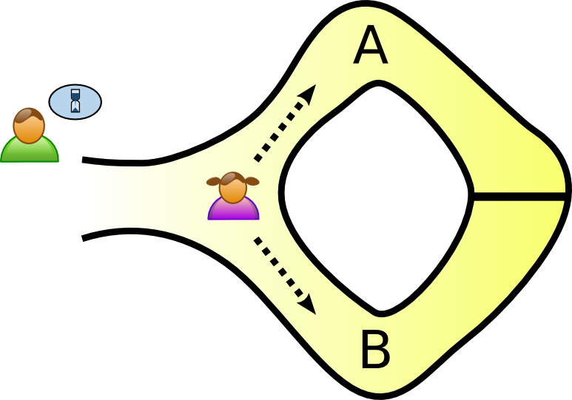
The cave example
Alice randomly choses a path A or B

Slide 5
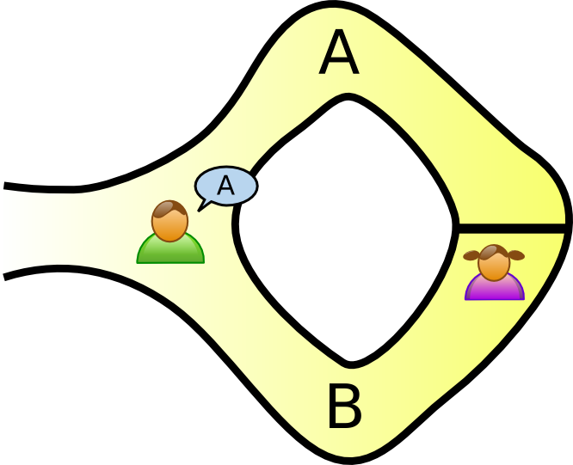
The cave example
Bob choses an exit

Slide 6
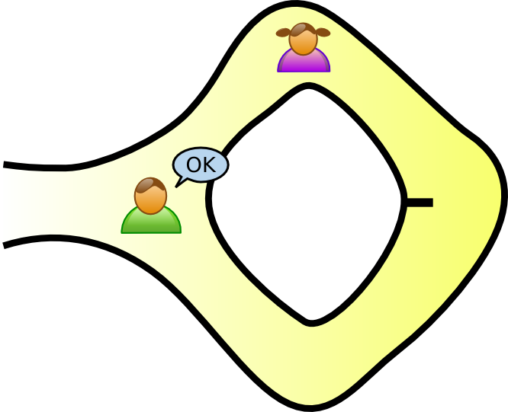
The cave example
Alice takes the exit Bob chosed and proves she can open the magic door

Slide 7
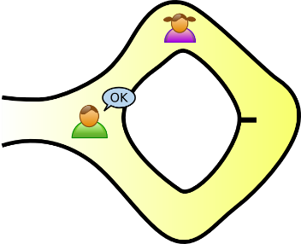
The cave example
Repeat many times to make the probability of guessing the right answer negligible.
(1/2)^1000 =
really really small probability

Slide 8

Schnorr protocol
Requirements: a cyclic group of order n and a generator g
Registration
The client writes his username and password.
The client hashes his password and sends $g^{H(password)}$ to the server which stores these information.

Slide 9

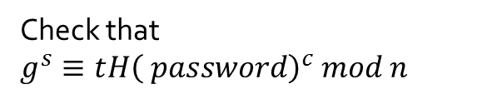
Schnorr protocol
Client
Server
T =
Pick random integer r
c
Pick random integer c
s
Computes s=rx+c
Check that
$g^{s}≡t{H\left( password\right)}^{c} mod n$

Slide 10
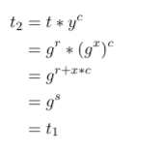
Proof of authentication
t2 – g^s
t1 – initial t sent by client (g^r) where
g – generator of cyclic group
r – random # chosen by client
Y – hash(x) where x is user’s password
c – random # chosen by server
s – calculated by client and sent ( = r + xc) =

Slide 11
Information held at each end
SERVER
n – order of cyclic group
g – generator of group
username & y – g^hash(password)
t1 - first t sent by client (=g^r)
c – random int chosen by server
s – computed and sent by client
CLIENT
n – order of cyclic group
g – generator of group
x – hash (password)
y – g ^ x
r – random in chosen by client
t1 – created by client ( = g^r)
c – random int chosen by server
s – computed response (=r + cx)
note the absence of x in SERVER!

Slide 12
Specifics of the ZK
The confidence in authentication each round of the ZKP comes from the size of the set of possible c’s
If a adversary guesses c before it is given, then they can choose r to be c and send g^c to the verifier. At this point, then the adversary has successfully verified that round.
(See next slide)
Thus, guessing c correctly has probability:
1/(number of possible c’s)
So with n rounds, the probability of false authentication is:
1/(number of possible c’s)^n

Slide 13

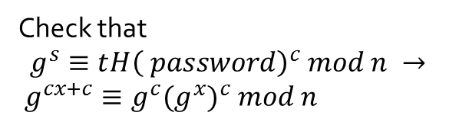
Schnorr protocol
Client
Server
T = $g^{c} mod n$
Guess the challenge integer c
c
Pick random integer c
s
Check that
$$g^{s}≡t{H\left( password\right)}^{c} mod n →$$
$g^{cx+c}≡g^{c}{(g^{x})}^{c} mod n$
Computes s=cx+c

Slide 14
Application to Online Voting
Server represents the organization/government
Client is the voter
The application of ZKP allows a voter to:
Register as a voter in the first place
With credentials, prove that the voter is who they say they are
Protects voters by keeping their credentials from being sent over a network
Once authenticated the user can then communicate with the organization

Slide 15
Demonstration

Slide 16
Problems Encountered
Calculations taking too long for a useful application due to:
Hashed password size
Slow exponentiation
Knowing when moding was appropriate and secure

Slide 17
Now lets dig into the code!

